Slide 2
Presentation Name
and Description
First & Last Name, Position
University or Affiliation
FULL DATE
LOCATION/ADDRESS
Notes:
Introduce yourself, your affiliation, etc.

Slide 3
Mission
A Brief History
In partnership with 160 countries worldwide, Fulbright offers passionate and accomplished faculty, administrator, artists, journalists, lawyers, and other professionals from all backgrounds an unparalleled opportunity to study, teach, or conduct research.
Our mission is to foster mutual understanding between nations, advance knowledge across communities, and improve lives around the world.
Established in 1946 by Congress, Fulbright is the United States government’s flagship international educational and cultural exchange program.
Fulbright is sponsored by the U.S. Department of State with funding provided by the U.S. Government and administered by the Institute of International Education.
Notes:
For this slide, it is important to stress that the Fulbright program is an international exchange program. The advancement of our mission of fostering mutual understanding between nations, advancing knowledge across communities, and improving lives around the world is the heart of Fulbright.

Slide 4
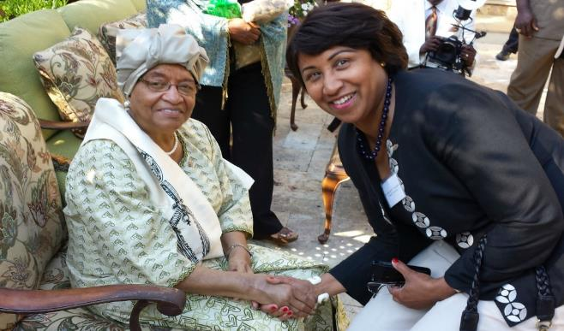
Diversity and Inclusion
Fulbright strives to ensure that it reflects the diversity of U.S. society and societies abroad. We encourage the involvement of people from traditionally underrepresented audiences in all our grants, programs and other initiatives.
Opportunities are open to people regardless of their race, color, national origin, sex, age, religion, geographic location, socioeconomic status, disability, sexual orientation or gender identity.
Notes:
We are actively recruiting a diverse pool of applicants for the Fulbright program. Please encourage all people to consider Fulbright.

Slide 5
Why Fulbright?
Fulbright is transformational.
Foster relationships that are real and lasting.
Expand your publishing network.
Become more multicultural in the classroom.
Serve as an ambassador for international exchange.
Gain the professional recognition as being identified as a “Fulbright Scholar.”
Join a vibrant alumni network.
Fulbright is family-friendly.
Approximately 60% of our awards provide dependent support.
Many Fulbright dependents go on to have international careers.
Fulbright is supportive.
Alumni share experiences.
Domestic and in-country staff provide assistance.
Notes:
Many of you may be wondering, “Why Fulbright?” Fulbright is unique in many ways.
First,
Fulbright is transformational.
Fulbright allows you to
Foster relationships that are real and lasting.
These relationships often lead to collaborative research. For example, one scholar I met at Georgia Tech talked about how a graduate student that he met while in Italy has made multiple trips to Georgia Tech so that they could further their research project.
Fulbright can
Expand your publishing network.
We often receive emails from our alumni who send us links to their publications, co-authored with their colleagues from their host countries.
Fulbrighters tend to
Become more multicultural in the classroom.
This benefits not only them, but also their students.
Fulbrighters
Serve as an ambassador for international exchange.
After their transformational international experience, many alumni encourage their fellow faculty members and students to apply for Fulbright programs. They also act as the catalyst to bring foreign scholars to their institutions for collaborative research.
You will
Gain the professional recognition as being identified as a “Fulbright Scholar.”
This recognition will continue throughout your career. Additionally, you will have the opportunity to join Fulbright events and serve as a peer reviewer.
Fulbright allows you to
Join a vibrant alumni network.
You can use the Fulbright network to raise the profile of your work because we constantly publicize the success of our Fulbright alumni through various channels.
Next,
Fulbright is family-friendly.
Approximately 60% of our awards provide dependent support.
What is dependent support? While it differs by award, awards can provide: additional airfare, additional monthly stipend, or educational allowance for K-12 dependents.
Additionally,
Many Fulbright dependents go on to have international careers.
Beyond the monetary support, Fulbright provides the opportunity to immerse oneself and one’s family in another culture. One 2-time alumni to Japan from Youngstown State University first took his children when they were adolescents. During his second Fulbright award, one of his daughters was finishing her undergraduate degree in Japan. Her experience as the child of a Fulbrighter prompted her to pursue her degree abroad and led her to an international career.
Finally,
Fulbright is supportive.
Our alumni directory is published online. Many applicants reach out to alumni during the application process. Then,
Alumni share experiences.
There is no better way to understand what a teaching or research award to Egypt is like than talking to someone who has had the experience. Alumni provide insights into the host culture, the application process, school options for accompanying children, and so much more.
Next,
Domestic and in-country staff provide assistance.
Fulbright staff is available to help you as you prepare to leave and while you are abroad. For example, if you have a medical issue while you are abroad, staff inside and outside the country can assist you.

Slide 6
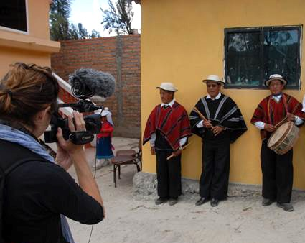
Fulbright by the Numbers
The Fulbright Program funds over 8,000 awards annually:
2,200 U.S. Students
4,000 foreign students
800 U.S. scholars and administrators
900 visiting scholars
400+ language teaching assistants
Approximately 390,000 “Fulbrighters” have participated in the program since its inception in 1946.
Notes:
The main purpose of this slide is to show that Fulbright is accessible because we offer a large number of awards every year.

Slide 7
Distribution of Awards
Fulbright awards allow academics and professionals to participate in a wide variety of activities:
Postdoctoral research (8%)
Administrator seminar (9%)
Teaching (17%)
Research (28%)
Teaching/Research (38%)
Notes:
This slide emphasizes the fact that Fulbright allows for a wide variety of activities, depending on the strengths and preferences of the applicants. Also let the audience know that this distribution changes from year to year because many awards allow you to choose your preferred activity. Activity preferences can change year by year.

Slide 8
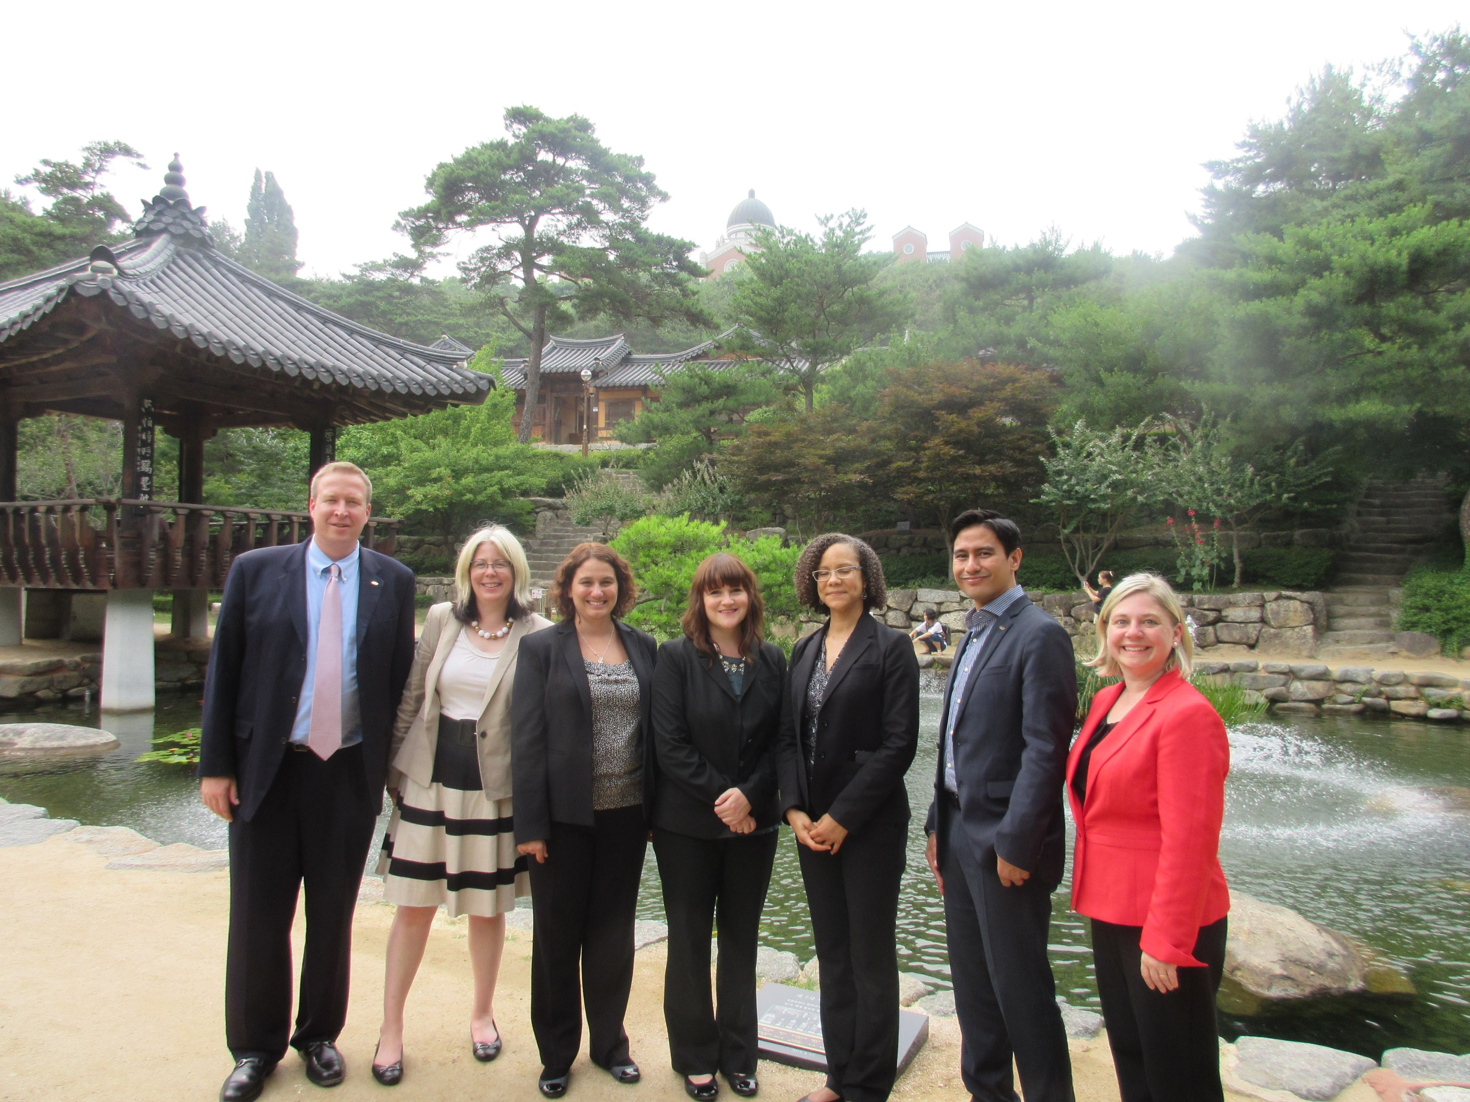
Eligibility for U.S. Scholar Program
U.S. citizenship
Degree and experience, as required by award:
Ph.D. or other terminal degree
MA and higher education teaching or professional experience
Professional and/or artistic experience with substantial accomplishments
Teaching experience
Compliance with policies on previous Fulbright Scholar awards and waiting periods between grants
Notes:
These are the overall eligibly requirements. The most essential one to keep in mind is that the program is only open to U.S. citizens. Green card holders are not eligible. For the “Degree and experience, as required by award” section, the categories listed are the most common ones seen in the “award requirements” tab.
The “policies” state that there must be 2 full years between the completion of a grant to the application deadline of the next grant.
Applicants can review the award description or contact the Fulbright office to review/confirm eligibility.

Slide 9
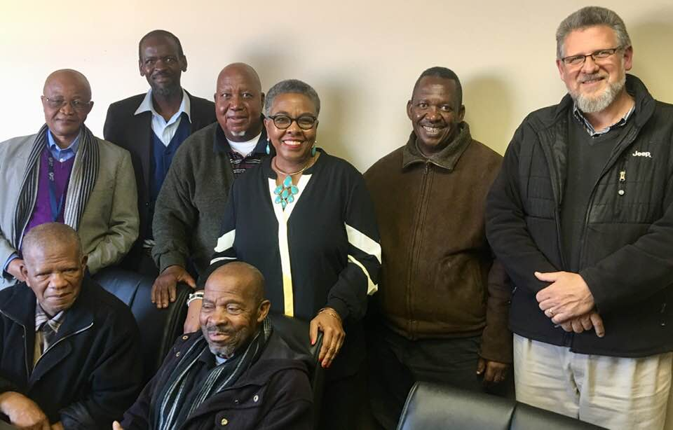
A Fulbright that Works for You
Awards throughout your career:
Postdoctoral
Early and mid-career
Distinguished chair
Emeriti, adjunct, independent scholar
Flex Option
Available in 63 countries and all world areas
Allows multiple visits over two years
Regional research awards
Notes:
Please talk about the flexibility of Fulbright. Most awards do take place during the academic year. However, the length of time varies from award to award. If someone asks about doing research during the summer, the “flex” option for countries that offer it allow the most flexibility. However, the majority of awards take place during the academic year of the host country.

Slide 10
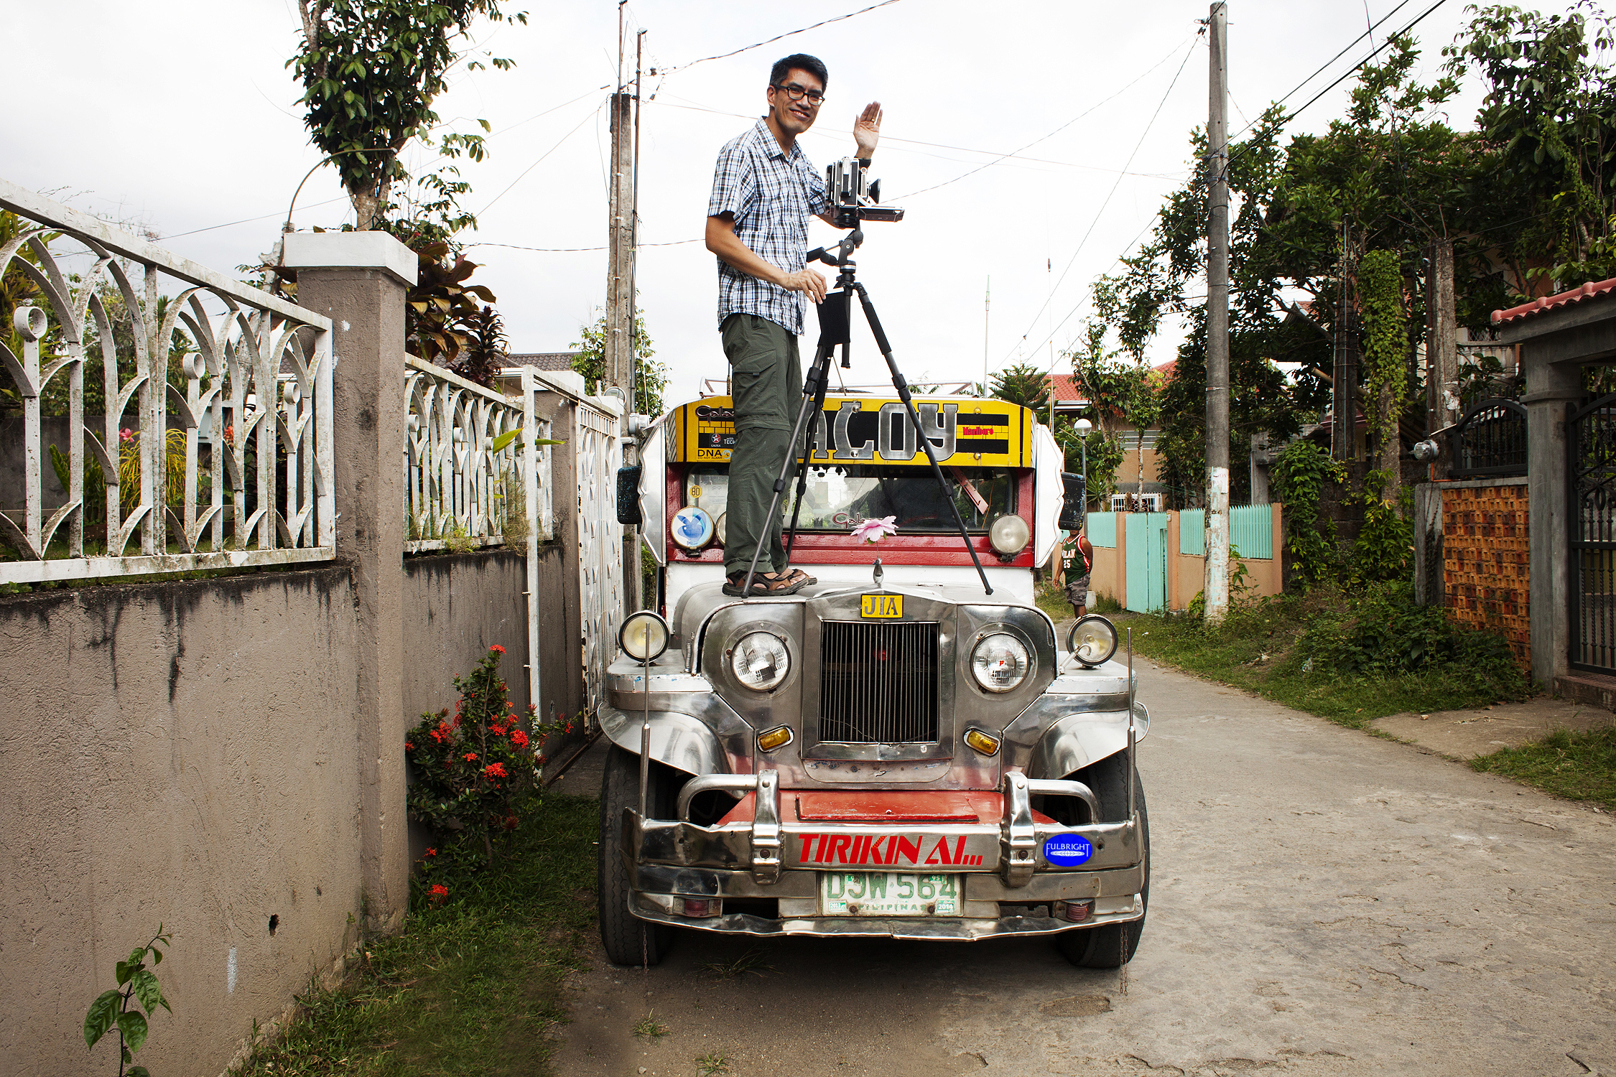
Selecting the Right Award
Match expertise, experience and proposal to the award description
Regional experience and language ability
Discipline preferences, when specified
Is the project relevant to the host country? How will communities benefit from your project?
Career level – postdoctoral, early career, mid-career, Distinguished Chair, administrator

Slide 11
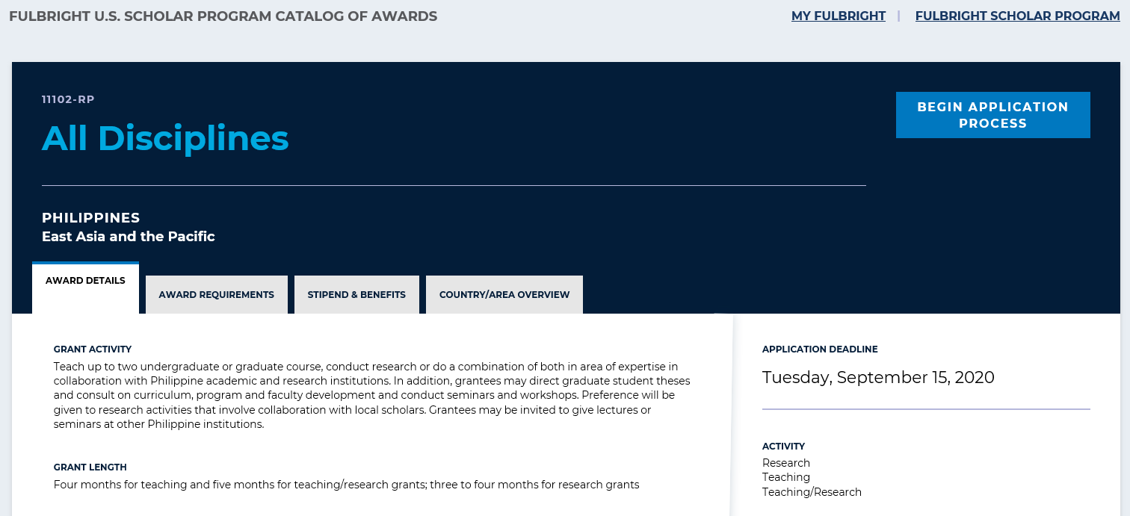
Understanding the Awards
https://awards.cies.org
Notes:
We do not want you to discuss specific details about awards because every single award is different. However, we would like for you to overview the kind of information they will find in each award description.
EVERY AWARD contains 4 parts:
award details
award requirements
award benefits
country/area overview
Potential applicants should carefully read the information on EVERY tab to understand the award completely.
Please encourage them to pay specific attention to the “Award Requirements” tab. This provides very important information about eligibility (e.g., language proficiency requirements and career status) and whether a letter of invitation is required or not. Again, I would encourage you to not answer specific questions about any award requirements because they differ in many awards. However, remind the audience to consult the “Award Requirements” tab and reach out to the Fulbright office if they have any questions or need clarification.

Slide 12
Application Components
Requirements:
Supplemental Materials:
Application Form
Project Statement
Curriculum Vitae or Resume
2 Letters of Recommendation
Language Proficiency Report (if required)
Letter of Invitation (if required)
Course outlines or syllabi (for teaching)
Select bibliography (for research)
Portfolio submissions (for artists, architects, and journalists)
Notes:
For this slide, it is important to stress that the Fulbright program is an international exchange program. The advancement of our mission of fostering mutual understanding between nations, advancing knowledge across communities, and improving lives around the world is the heart of Fulbright. This must come through in the project statement.

Slide 13
Application Cycle
FEBRUARY
Awards Catalog Opens
SEPTEMBER 15
Application Deadline
SEPTEMBER
Program staff conducts technical reviews for completeness
OCTOBER – NOVEMBER
U.S. peer review
NOVEMBER – JANUARY
Applicants notified of status. Recommended applications are sent to host countries and to the J. William Fulbright Foreign Scholarship Board.
JANUARY – APRIL
Grantees are notified of final approvals
MAY – ONWARD
Grantees prepare for grants
Notes:
This is the general timeline for awards. Make sure the applicants understand that they need to apply 1 academic year before their hope to go abroad.

Slide 14
Other Fulbright Opportunities

Slide 15
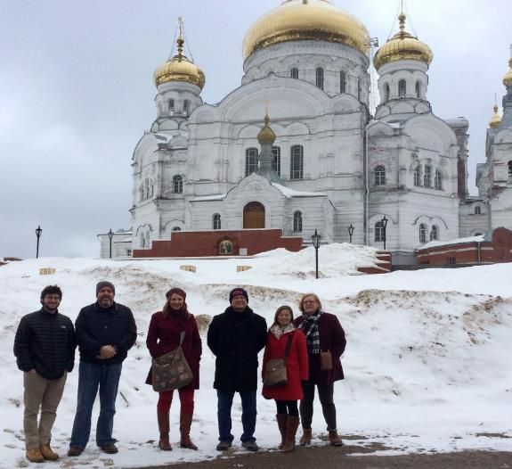
International Education Administrators Seminars
Europe
Asia
France (October)
Germany (October)
Russia Community College Administrators Seminar (April)
India (March)
Japan (June)
Korea (June)
Taiwan (April)
Notes:
Open to international education professionals and higher education administrators
Seminars approximately 2 weeks
Provide opportunity to learn about another country’s higher education system
Allow you to establish a network of U.S. and international colleagues in the field of international education

Slide 16
Institutional Opportunities
Fulbright Scholar-in-Residence (S-I-R) Program
Fulbright Outreach Lecturing Fund (OLF)
Fulbright Language Teaching Assistant (FLTA) Program
Host scholars from other countries to teach primarily at the undergraduate level for a semester or an academic year
Website: cies.org/sir
Email: SIR@iie.org
Host current Fulbright Visiting Scholars for short-term lectureships of 2 – 6 days on discipline or cultural topics to internationalize the campus
Website: cies.org/olf
Email: OLF@iie.org
Host native speaking language teaching assistants to enhance students’ understanding different languages and cultures
Website: foreign.fulbrightonline.org
Email: Dcook@iie.org
Notes:
SIR – The Fulbright Scholar-in-Residence (S-I-R) Program assists U.S. higher education institutions in expanding programs of academic exchange, by supporting non-U.S. scholars through grants for teaching at institutions that might not have a strong international component and/or serve minority audiences. Both the U.S. institution and the scholar grantee benefit from this experience.
OLF – The Outreach Lecturing Fund (OLF) provides funding for campuses to host Fulbright Visiting Scholars, already in the United States, for short-term speaking engagements. To see a list of current Visiting Scholars in the U.S. please visit our Scholar Directory. The OLF travel award is designed to enrich both institutions and Visiting Scholars through lectures that will promote academic disciplines and cultural understanding.
FLTA - The Fulbright Foreign Language Teaching Assistant (FLTA) Program supports language assistantships at universities and colleges throughout the U.S., providing institutions with an opportunity to enhance their language programming and expose students to native speakers who bring an energetic, up-to-date cultural component to the foreign language classroom as well as student life at a campus in general.

Slide 17
Additional Fulbright U.S. Programs
Scholars
Students
Teachers
Arctic Initiative
Arctic@iie.org
Group Projects Abroad Program
GPA@ed.gov
Specialist Program
FulbrightSpecialist@worldlearning.org
Doctoral Dissertation Research Abroad Program
DDRA@ed.gov
English Teaching Assistant (ETA) Program
FBstudent@iie.org
Student Program
FBstudent@iie.org
Distinguished Award in Teaching Program
FulbrightDA@irex.org
Group Projects Abroad
GPA@ed.gov
Teachers for Global Classrooms
FulbrightTGC@irex.org
Notes:
This slide should be a basic overview of the wide variety of “Fulbright” programs, administered by IIE or other DOS partners. You do not need to be an expert on each of these programs, but I included a sentence or so below about each so you can be informed. Please encourage the audience to reach out using the appropriate email to ask further questions.
U.S. Scholars
Arctic Initiative - The Fulbright Arctic Initiative creates a network to stimulate international scientific collaboration on Arctic issues while increasing mutual understanding between people of the United States and the people of other countries. Using a collaborative model to translate theory into practice, program participants address public-policy research questions relevant to Arctic nations’ shared challenges and opportunities.
Fulbright-Hays Group Projects Abroad Program - Funding to spend time in a foreign country or region acquiring resource materials for curriculum development in modern foreign languages or area studies programs
Fulbright Specialist - The Fulbright Specialist Program is a unique opportunity for U.S. academics and established professionals to engage in two- to six-week, project-based exchanges at host institutions across the globe.
U.S. Students
ETA - Places grantees in schools overseas to supplement local English language instruction and to provide a native speaker presence in the classrooms
Fulbright-Hays Doctoral Dissertation Research Abroad Program - Funding for individual doctoral students who conduct research in other countries in modern foreign languages and area studies for periods of six to 12 months
Fulbright U.S. Student Program - Recent graduates, post-graduate candidates through dissertation level, developing professionals and artists to study and research abroad
U.S. Teachers
Fulbright Distinguished Award in Teaching Program - K-12 educators can take part in a three-to six-month professional development experience abroad, pursue individual inquiry projects, take courses at a host university, and collaborate with colleagues on best educational practices
Fulbright-Hays Group Projects Abroad - Funding to spend time in a foreign country or region acquiring resource materials for curriculum development in modern foreign languages or area studies programs
Fulbright Teachers for Global Classrooms - Fulbright TGC is a year-long professional development opportunity for U.S. elementary, middle, and high school teachers to develop skills for preparing students for a competitive global economy.

Slide 18
Stay connected with us.
Join MyFulbright at cies2.org
Email us at scholars@iie.org
Visit our website to learn more about the Fulbright U.S. Scholar Program
Refer your colleagues

