Slide 2
Presentation Name
and Description
First & Last Name, Position
University or Affiliation
FULL DATE
LOCATION/ADDRESS
Notes:
Introduce yourself, your affiliation, etc.

Slide 3
Mission
A Brief History
In partnership with 160 countries worldwide, Fulbright offers passionate and accomplished faculty, administrator, artists, journalists, lawyers, and other professionals from all backgrounds an unparalleled opportunity to study, teach, or conduct research.
Our mission is to foster mutual understanding between nations, advance knowledge across communities, and improve lives around the world.
Established in 1946 by Congress, Fulbright is the United States government’s flagship international educational and cultural exchange program.
Fulbright is sponsored by the U.S. Department of State with funding provided by the U.S. Government and administered by the Institute of International Education.
Notes:
For this slide, it is important to stress that the Fulbright program is an international exchange program. The advancement of our mission of fostering mutual understanding between nations, advancing knowledge across communities, and improving lives around the world is the heart of Fulbright.

Slide 4
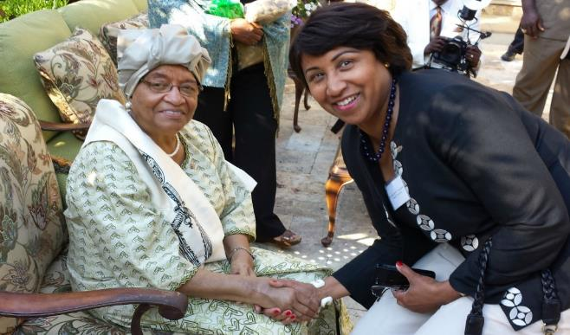
Diversity and Inclusion
Fulbright strives to ensure that it reflects the diversity of U.S. society and societies abroad. We encourage the involvement of people from traditionally underrepresented audiences in all our grants, programs and other initiatives.
Opportunities are open to people regardless of their race, color, national origin, sex, age, religion, geographic location, socioeconomic status, disability, sexual orientation or gender identity.
Notes:
We are actively recruiting a diverse pool of applicants for the Fulbright program. Please encourage all people to consider Fulbright. Ellen Johnson Sirleaf, President of Liberia 2006-2018, first elected female head of state in Africa with Jeanne Toungara former associate provost at Howard U and emerita Alumna Ambassador

Slide 5
Why Fulbright?
Fulbright is transformational.
Foster relationships that are real and lasting.
Expand your publishing network.
Become more multicultural in the classroom.
Serve as an ambassador for international exchange.
Gain the professional recognition as being identified as a “Fulbright Scholar.”
Join a vibrant alumni network.
Fulbright is family-friendly.
Approximately 60% of our awards provide dependent support.
Many Fulbright dependents go on to have international careers.
Fulbright is supportive.
Alumni share experiences.
Domestic and in-country staff provide assistance.
Notes:
Many of you may be wondering, “Why Fulbright?” Fulbright WANTS you to come back transformed. Fulbright is unique in many ways – often times it's not themselves that need convincing but family, friends, chairs, colleagues, so here are some examples we've collected to share.
First,
Fulbright is transformational.
Fulbright allows you to
Foster relationships that are real and lasting.
These relationships often lead to collaborative research. For example, one scholar I met at Georgia Tech talked about how a graduate student that he met while in Italy has made multiple trips to Georgia Tech so that they could further their research project.
Fulbright can
Expand your publishing network.
We often receive emails from our alumni who send us links to their publications, co-authored with their colleagues from their host countries.
Fulbrighters tend to
Become more multicultural in the classroom.
This benefits not only them, but also their students.
Fulbrighters
Serve as an ambassador for international exchange.
After their transformational international experience, many alumni encourage their fellow faculty members and students to apply for Fulbright programs. They also act as the catalyst to bring foreign scholars to their institutions for collaborative research.
You will
Gain the professional recognition as being identified as a “Fulbright Scholar.”
This recognition will continue throughout your career. Additionally, you will have the opportunity to join Fulbright events and serve as a peer reviewer.
Fulbright allows you to
Join a vibrant alumni network.
You can use the Fulbright network to raise the profile of your work because we constantly publicize the success of our Fulbright alumni through various channels.
Next,
Fulbright is family-friendly.
Approximately 60% of our awards provide dependent support.
What is dependent support? While it differs by award, awards can provide: additional airfare, additional monthly stipend, or educational allowance for K-12 dependents.
Additionally,
Many Fulbright dependents go on to have international careers.
Beyond the monetary support, Fulbright provides the opportunity to immerse oneself and one’s family in another culture. One 2-time alumni to Japan from Youngstown State University first took his children when they were adolescents. During his second Fulbright award, one of his daughters was finishing her undergraduate degree in Japan. Her experience as the child of a Fulbrighter prompted her to pursue her degree abroad and led her to an international career.
Finally,
Fulbright is supportive.
Our alumni directory is published online. Many applicants reach out to alumni during the application process. Then,
Alumni share experiences.
There is no better way to understand what a teaching or research award to Egypt is like than talking to someone who has had the experience. Alumni provide insights into the host culture, the application process, school options for accompanying children, and so much more.
Next,
Domestic and in-country staff provide assistance.
Fulbright staff is available to help you as you prepare to leave and while you are abroad. For example, if you have a medical issue while you are abroad, staff inside and outside the country can assist you.

Slide 6
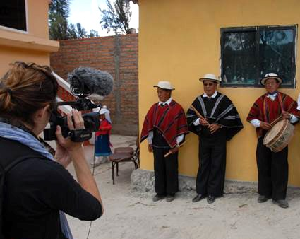
Fulbright by the Numbers
The Fulbright Program funds over 8,000 awards annually:
800 U.S. scholars and administrators
900 visiting scholars
2,200 U.S. students
4,000 foreign students
400+ language teaching assistants
Approximately 390,000 “Fulbrighters” have participated in the program since its inception in 1946.
Notes:
The main purpose of this slide is to show that Fulbright is accessible because we offer a large number of awards every year. While scholar is the smallest piece of this puzzle, it is the most strategic. All of the other programs are only possible through the development of the relationships that faculty foster and create while on their Fulbrights.

Slide 7
Distribution of Opportunities 2022-2023
Fulbright awards allow academics and professionals to participate in a wide variety of activities:
Teaching/Research (38%)
Research (28%)
Teaching (17%)
Administrator seminar (9%)
Postdoctoral research (8%)
Notes:
Highlight they should be telling grad students about post-docs. This slide emphasizes the fact that Fulbright allows for a wide variety of activities, depending on the strengths and preferences of the applicants. Also let the audience know that this distribution changes from year to year because many awards allow you to choose your preferred activity. Activity preferences can change year by year. At the heart of its mission is people to people exchange and encounter, with more than half of our awards involving an element of classroom teaching.

Slide 8
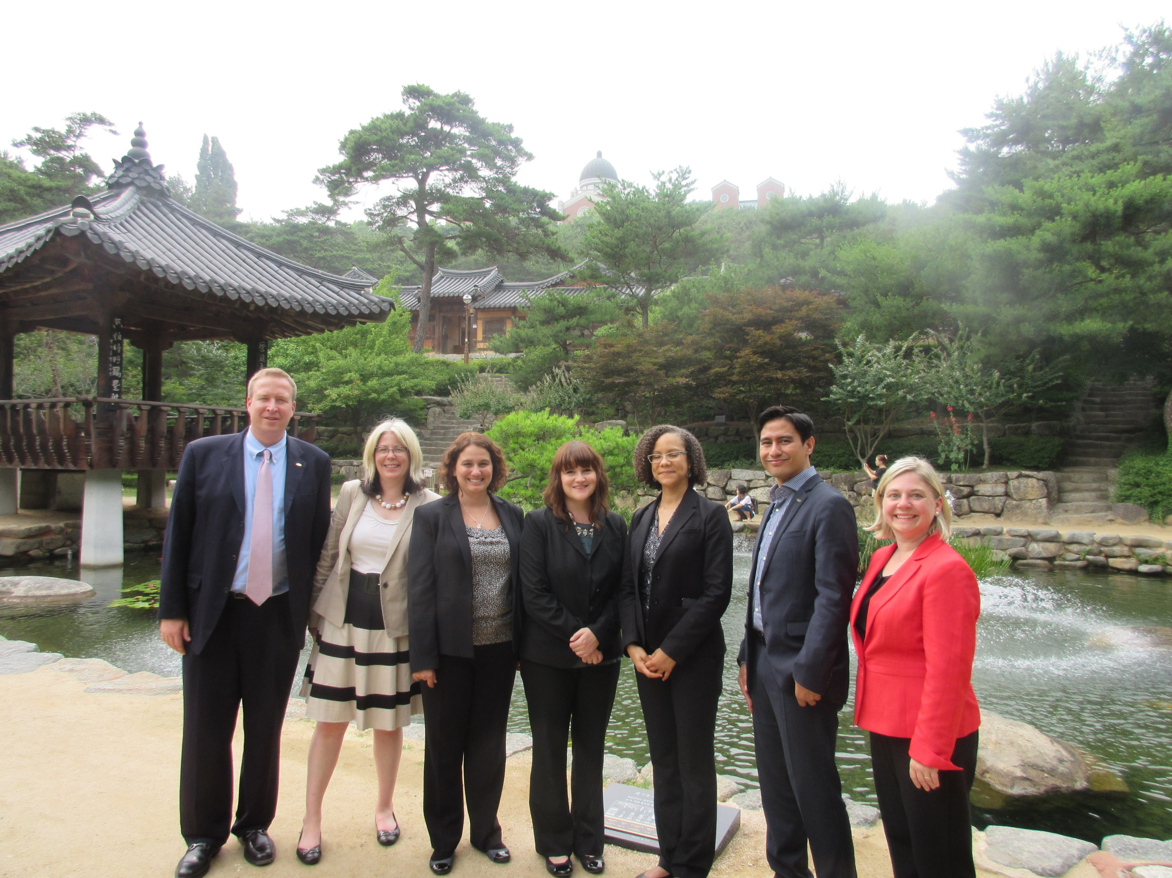
Eligibility for U.S. Scholar Program
U.S. citizenship
Degree and experience, as required by award:
Ph.D. or other terminal degree
MA and higher education teaching or professional experience
Professional and/or artistic experience with substantial accomplishments
Teaching experience
Compliance with policies on previous Fulbright Scholar awards and waiting periods between grants
Notes:
These are the overall eligibly requirements. The most essential one to keep in mind is that the program is only open to U.S. citizens. Green card holders are not eligible. For the “Degree and experience, as required by award” section, the categories listed are the most common ones seen in the “award requirements” tab.
The “policies” state that there must be 2 full years between the completion of a grant to the application deadline of the next grant.
Applicants can review the award description or contact the Fulbright office to review/confirm eligibility.
I usually pause here and ask if there are any Fulbrighters in the room to gauge how much detail I have to go into for the final bullet.

Slide 9
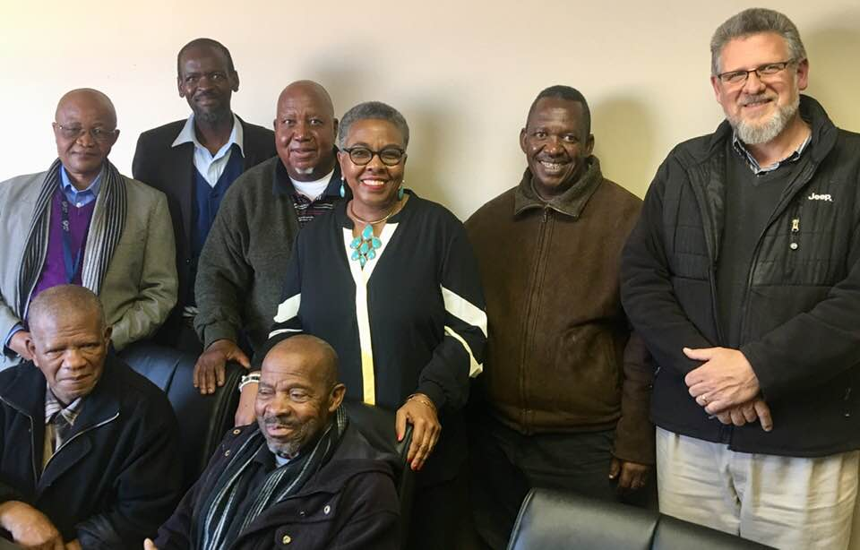
Fulbright Scholar Award Types
4 Award Types:
Fulbright Scholar Awards
Fulbright Post-Doctoral Awards
Fulbright Distinguished Scholars Awards
Fulbright International Education Administrator Awards
Flex Option
Available in 63 countries and all world areas
Allows multiple visits over two years
Global & Regional awards
Notes:
Regional Research Awards exist in most world regions: EU Schuman, Carlos-Rico North American Studies, Cross Strait Studies (EAP), Please talk about the flexibility of Fulbright. Most awards do take place during the academic year. However, the length of time varies from award to award. If someone asks about doing research during the summer, the “flex” option for countries that offer it allow the most flexibility. However, the majority of awards take place during the academic year of the host country.

Slide 10
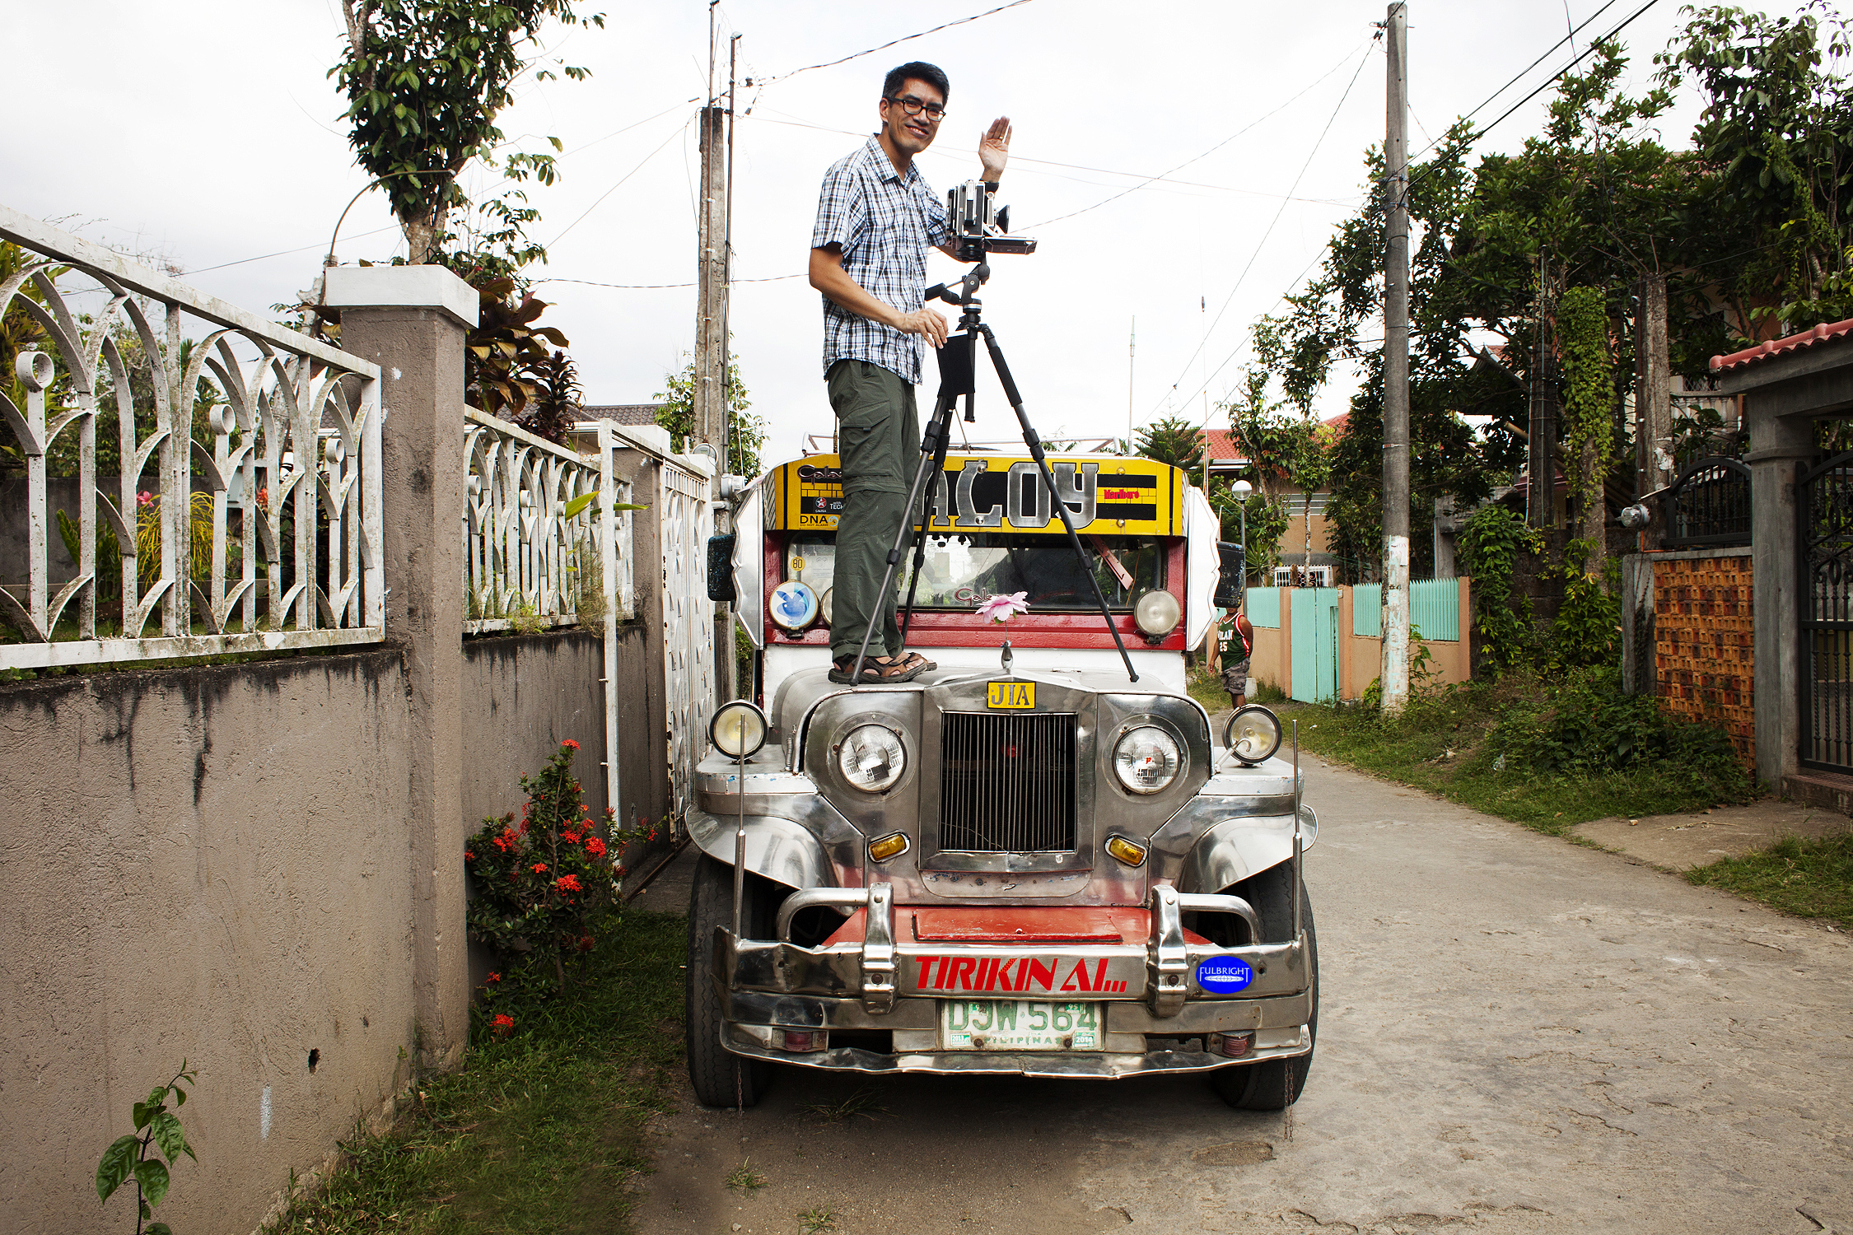
Things to consider when choosing an award
How does it benefit you professionally?
How does it benefit you personally?
How does it benefit your family? (if applicable)
How does it fit with your financial situation?
Notes:
I say there's a Fulbright for everyone somewhere in the world, but not a Fulbright for everyone, everywhere in the world. You have to find a good fit for what you want to do and a country/award who understands its value.
ABD – mention U.S. Student Program
Career level – early career, mid-career, senior level, administrator, professional, artist, Emeriti, Adjunct, and independent scholar

Slide 11
Things to consider when choosing an award
Match country interest, expertise, career profile, and proposal to the award description
Language ability (if applicable)
Discipline preferences, when specified
Project relevance to the host country and/or institution
Benefits to you and your community
Notes:
I say there's a Fulbright for everyone somewhere in the world, but not a Fulbright for everyone, everywhere in the world. You have to find a good fit for what you want to do and a country/award who understands its value.
ABD – mention U.S. Student Program
Career level – early career, mid-career, senior level, administrator, professional, artist, Emeriti, Adjunct, and independent scholar

Slide 12
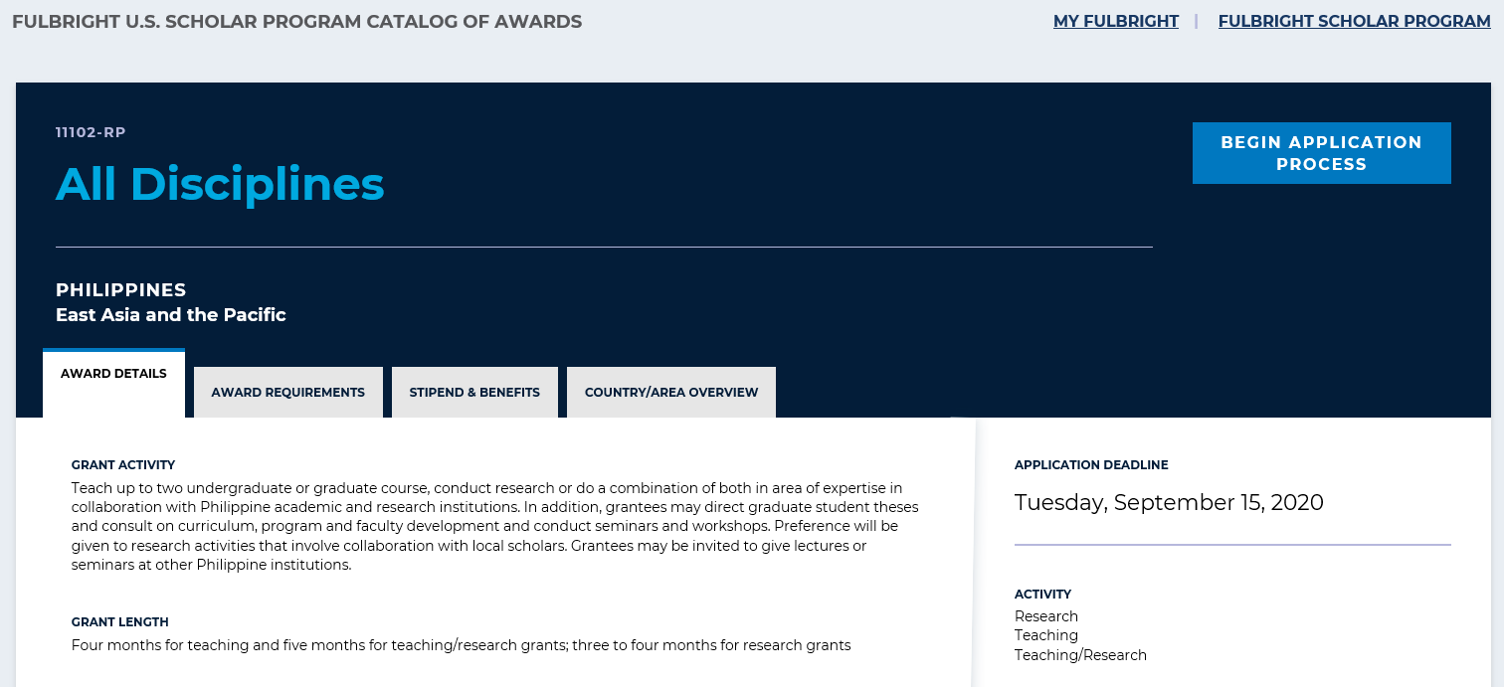
Understanding the Awards
https://awards.cies.org
Notes:
We do not want you to discuss specific details about awards because every single award is different. However, we would like for you to overview the kind of information they will find in each award description.
EVERY AWARD contains 4 parts:
award details
award requirements
award benefits
country/area overview
Potential applicants should carefully read the information on EVERY tab to understand the award completely.
Please encourage them to pay specific attention to the “Award Requirements” tab. This provides very important information about eligibility (e.g., language proficiency requirements and career status) and whether a letter of invitation is required or not. Again, I would encourage you to not answer specific questions about any award requirements because they differ in many awards. However, remind the audience to consult the “Award Requirements” tab and reach out to the Fulbright office if they have any questions or need clarification.

Slide 13
Application Components
Requirements:
Supplemental Materials:
Application Form
Project Statement
Curriculum Vitae or Resume
2 Letters of Recommendation
Language Proficiency Report (if required)
Letter of Invitation (if required)
Course outlines or syllabi (for teaching)
Select bibliography (for research)
Portfolio submissions (for artists, architects, and journalists)
Notes:
Each component is a piece of a puzzle – applicants should maximize the effectiveness of each component in telling the story and making the case for their project.
Sign up for periodic updates in MyFulbright and to start your application, we don't need that much information at the start, so plug in early, the earlier you start, the sooner you get staff support.
For this slide, it is important to stress that the Fulbright program is an international exchange program. The advancement of our mission of fostering mutual understanding between nations, advancing knowledge across communities, and improving lives around the world is the heart of Fulbright. This must come through in the project statement.

Slide 14
Application Cycle
FEBRUARY
Awards Catalog Opens
SEPTEMBER 15
Application Deadline
SEPTEMBER
Program staff conducts technical reviews for completeness
OCTOBER – NOVEMBER
U.S. peer review
NOVEMBER – JANUARY
Applicants notified of status. Recommended applications are sent to host countries and to the Fulbright Foreign Scholarship Board.
JANUARY – APRIL
Final decisions are made
MAY – ONWARD
Participants prepare for departure
Notes:
Drive home that February we open September we close, Sept 2021 is for fall 2022. Sept 2022 is for fall 2023....
This is the general timeline for awards. Make sure the applicants understand that they need to apply 1 academic year before their hope to go abroad.

Slide 15
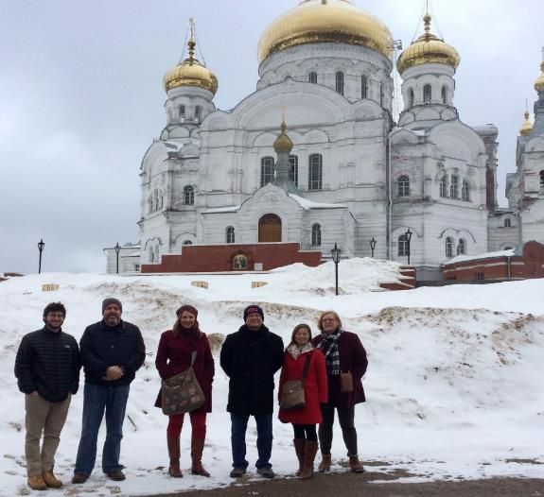
International Education Administrators Awards
IEAs are seminars that help U.S. international education professionals and senior higher education officials establish empowering connections with their counterparts and higher education systems of other countries.
Europe
Asia
France (October)
Germany (October)
Russia Community College Administrators Award (April)
Taiwan (April)
South Korea (June)
Japan (June)
India (available for 2023-24)
For more information, please email IEA@iie.org
Notes:
Open to international education professionals and higher education administrators
Seminars approximately 2 weeks
Provide opportunity to learn about another country’s higher education system
Allow you to establish a network of U.S. and international colleagues in the field of international education
France is looking for SENIOR administrators, Presidents, Provosts, VPs – strategic engagement

Slide 16
Bring Foreign Fulbrighters to your Campus
Fulbright Scholar-in-Residence (S-I-R) Program
Fulbright Outreach Lecturing Fund (OLF)
Fulbright Language Teaching Assistant (FLTA) Program
Host scholars from other countries to teach for a semester or an academic year
Website: cies.org/sir
Email: SIR@iie.org
Host current Fulbright Visiting Scholars for short-term lectureships of 2 – 6 days on discipline or cultural topics to internationalize the campus
Website: cies.org/olf
Email: OLF@iie.org
Host native speaking language teaching assistants to enhance students’ understanding different languages and cultures
Website: foreign.fulbrightonline.org
Email: Dcook@iie.org
Notes:
SIR – The Fulbright Scholar-in-Residence (S-I-R) Program assists U.S. higher education institutions in expanding programs of academic exchange, by supporting non-U.S. scholars through grants for teaching at institutions that might not have a strong international component and/or serve minority audiences. Both the U.S. institution and the scholar grantee benefit from this experience.
OLF – The Outreach Lecturing Fund (OLF) provides funding for campuses to host Fulbright Visiting Scholars, already in the United States, for short-term speaking engagements. To see a list of current Visiting Scholars in the U.S. please visit our Scholar Directory. The OLF travel award is designed to enrich both institutions and Visiting Scholars through lectures that will promote academic disciplines and cultural understanding.
FLTA - The Fulbright Foreign Language Teaching Assistant (FLTA) Program supports language assistantships at universities and colleges throughout the U.S., providing institutions with an opportunity to enhance their language programming and expose students to native speakers who bring an energetic, up-to-date cultural component to the foreign language classroom as well as student life at a campus in general.

Slide 17
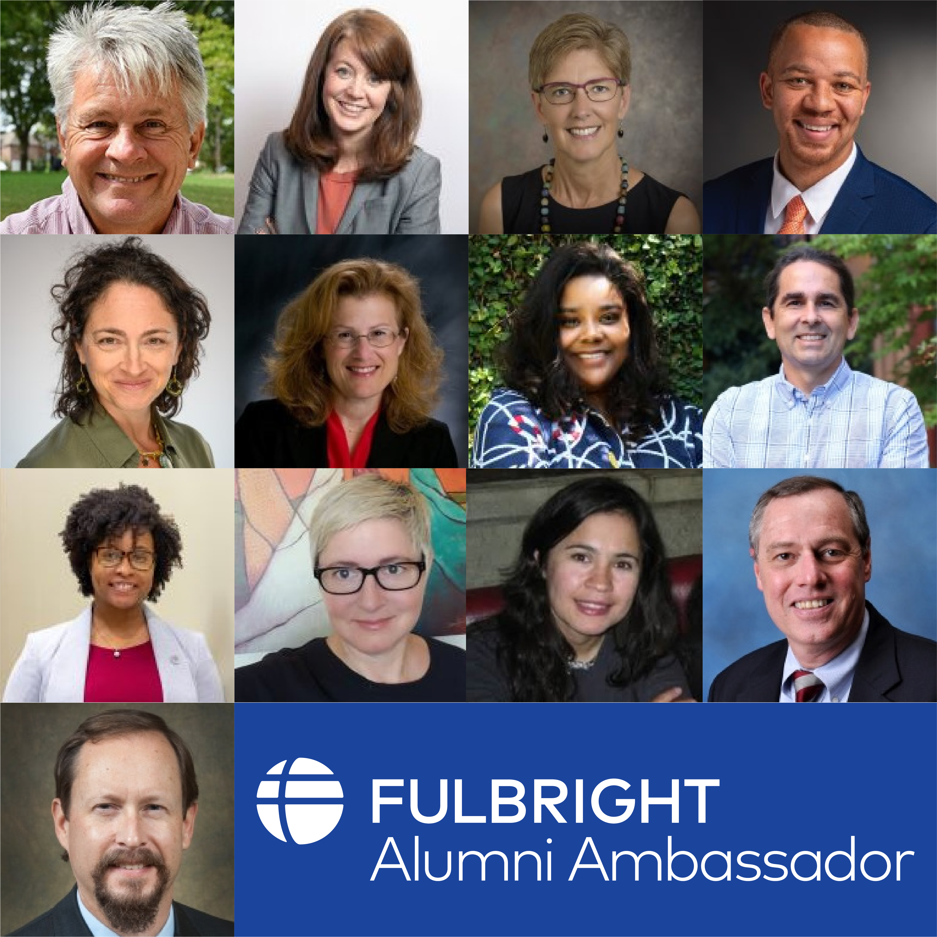
Invite a Fulbright Alumni Ambassador
Fulbright U.S. Scholar Alumni Ambassadors are official representatives of the program and care share with your faculty and administrators about the impact their Fulbright had on them personally and professionally, as well as on their institution.
72
Emeriti Ambassadors
13
New Ambassadors
60
+ Events Annually
More information on inviting an Ambassador can be found on: cies.org/alumni-ambassadors
Notes:
Open to international education professionals and higher education administrators
Seminars approximately 2 weeks
Provide opportunity to learn about another country’s higher education system
Allow you to establish a network of U.S. and international colleagues in the field of international education
France is looking for SENIOR administrators, Presidents, Provosts, VPs – strategic engagement

Slide 18
Additional Fulbright U.S. Programs
Scholars
Students
Teachers
Arctic Initiative
Arctic@iie.org
Fulbright-Hays Group Projects Abroad Program
GPA@ed.gov
Specialist Program
FulbrightSpecialist@worldlearning.org
Fulbright-Hays Doctoral Dissertation Research Abroad Program
DDRA@ed.gov
English Teaching Assistant (ETA) Program
FBstudent@iie.org
Student Program
FBstudent@iie.org
Distinguished Award in Teaching Research Program
FulbrightDA@irex.org
Group Projects Abroad
GPA@ed.gov
Teachers for Global Classrooms
FulbrightTGC@irex.org
Notes:
This slide should be a basic overview of the wide variety of “Fulbright” programs, administered by IIE or other DOS partners. You do not need to be an expert on each of these programs, but I included a sentence or so below about each so you can be informed. Please encourage the audience to reach out using the appropriate email to ask further questions.
U.S. Scholars
Arctic Initiative – LIVE: Deadline May 11! The Fulbright Arctic Initiative creates a network to stimulate international scientific collaboration on Arctic issues while increasing mutual understanding between people of the United States and the people of other countries. Using a collaborative model to translate theory into practice, program participants address public-policy research questions relevant to Arctic nations’ shared challenges and opportunities. Canada open, Norway midyear, DC final.
Fulbright-Hays Group Projects Abroad Program - Funding to spend time in a foreign country or region acquiring resource materials for curriculum development in modern foreign languages or area studies programs
Fulbright Specialist - The Fulbright Specialist Program is a unique opportunity for U.S. academics and established professionals to join a roster of candidates who are eligible to engage in two- to six-week, project-based exchanges at host institutions across the globe. Institutionally driven from overseas, so projects must be approved for funding abroad before matches take place.
U.S. Students
ETA - Places grantees in schools overseas to supplement local English language instruction and to provide a native speaker presence in the classrooms
Fulbright-Hays Doctoral Dissertation Research Abroad Program - Funding for individual doctoral students who conduct research in other countries in modern foreign languages and area studies for periods of six to 12 months
Fulbright U.S. Student Program - Recent graduates, post-graduate candidates through dissertation level, developing professionals and artists to study and research abroad
U.S. Teachers
Fulbright Distinguished Award in Teaching Program - K-12 educators can take part in a three-to six-month professional development experience abroad, pursue individual inquiry projects, take courses at a host university, and collaborate with colleagues on best educational practices
Fulbright-Hays Group Projects Abroad - Funding to spend time in a foreign country or region acquiring resource materials for curriculum development in modern foreign languages or area studies programs
Fulbright Teachers for Global Classrooms - Fulbright TGC is a year-long professional development opportunity for U.S. elementary, middle, and high school teachers to develop skills for preparing students for a competitive global economy.

Slide 19
Stay connected with us.
Join MyFulbright at cies2.org
Email us at scholars@iie.org
Visit our website to learn more about the Fulbright U.S. Scholar Program
Refer your colleagues
Notes:
Sign up for MyFulbright, follow all our media for inspiration and stories, refer your colleagues!

Slide 20
Notes:
Within the Fulbright Application system, preliminary questions will impact the information that will be visible on subsequent pages of the application. As such, these must be answered correctly.
Short answer questions:
Essays: The heart of the application. This is where you should address the what, when, where, why, and how of your Fulbright project.
The Statement of Grant Purpose for S/R awards is a 2-page document detailing an intellectually-compelling and feasible project proposal or justification for pursuing a graduate degree program.
The Statement of Grant Purpose should make it clear why you must go to the host country in order to complete your proposed research or study program, and that you have the requisite academic or professional experience and language skills to fulfill your proposal.
The Statement of Grant Purpose for ETA awards is a 1-page document detailing why you are interested in teaching English to non-native speakers, as well as why you have chosen to apply to a particular country.
The Statement should describe any teaching or related experience, while clearly describing what you will bring to the classroom in the host country; including lesson plans, activity ideas, and educational strategies you plan to implement.
The Personal Statement is a 1-page biography in narrative form. It is an opportunity to introduce yourself to the screening committee members on a personal level.
The style is up to the writer, but the content should convey one's background and motivation for applying to the program and how this opportunity fits into one's future plans.

